Slide 1
CNTK: Microsoft's Open-Source Deep-Learning Toolkit
Frank Seide
Principal Researcher Speech Recognition, CNTK Architect
With many contributors:
A. Agarwal, E. Akchurin, C. Basoglu, G. Chen, S. Cyphers, J. Droppo, A. Eversole, B. Guenter, M.Hillebrand, X. Huang, Z. Huang, V. Ivanov, A. Kamenev, P. Kranen, O. Kuchaiev, W. Manousek, A. May, B. Mitra, O. Nano, G. Navarro, A. Orlov, M. Padmilac, H. Parthasarathi, B. Peng, A. Reznichenko, M. Seltzer, M. Slaney, A. Stolcke, H. Wang, K. Yao, D. Yu, Y. Zhang, G. Zweig

Slide 2
(hidden) intro, self intro
I was first to show that DNNs work for production-scale speech recognition (Switchboard); (also the person who built the first Skype Translator prototype with my team, see demo later); now playing the role of an architect for CNTK
in this talk, I will tell you
what CNTK can do for you (what problems it can solve, how it fits)
how it does it (a look under the hood)
walk-through through two non-trivial examples

Slide 3







deep learning in the company
Bing
Cortana
ads
relevance
multimedia
…
Skype Translator
HoloLens
Microsoft Research
speech, image, text

Slide 4
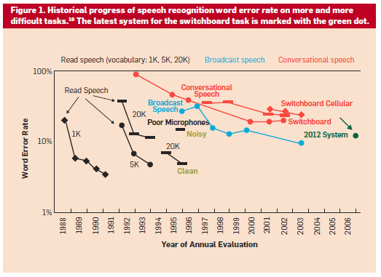
2015 System
Human Error Rate 4%

Slide 5
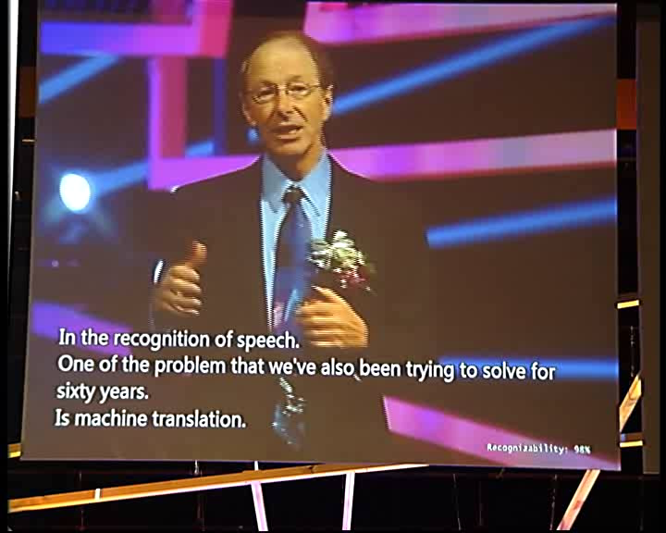
Notes:
show video from 4:45, to demonstrate transcription

Slide 6
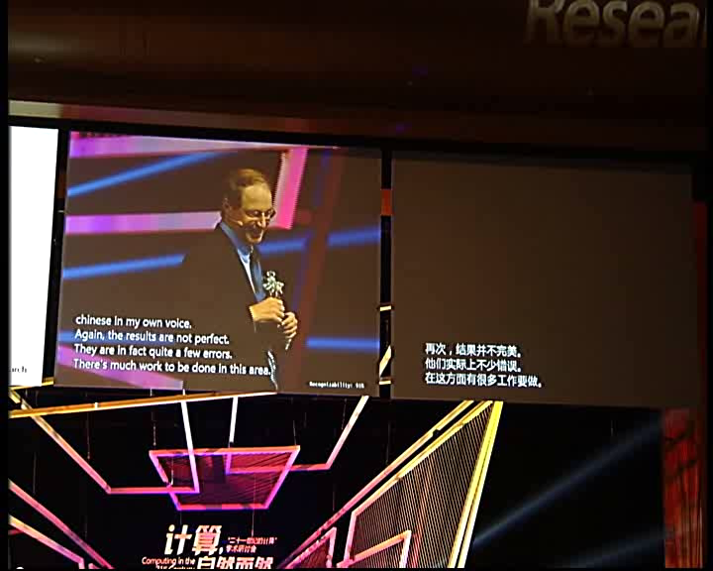
Notes:
show video from 7:55, to demonstrate translation

Slide 7
ImageNet: Microsoft 2015 ResNet
Microsoft had all 5 entries being the 1-st places this year: ImageNet classification, ImageNet localization, ImageNet detection, COCO detection, and COCO segmentation

Slide 8
I. what is CNTK II. how to use CNTK III. deep dive into CNTK technologies IV. examples source-code walkthroughs

Slide 9
CNTK “Computational Network Toolkit”
CNTK is Microsoft’s open-source, cross-platform toolkit for learning and evaluating deep neural networks.
CNTK expresses (nearly) arbitrary neural networks by composing simple building blocks into complex computational networks, supporting relevant network types and applications.
CNTK is production-ready: State-of-the-art accuracy, efficient, and scales to multi-GPU/multi-server.

Slide 10
“CNTK is Microsoft’s open-source, cross-platform toolkit for learning and evaluating deep neural networks.”
open-source model inside and outside the company
created by Microsoft Speech researchers (Dong Yu et al.) 4 years ago; open-sourced (CodePlex) in early 2015
on GitHub since Jan 2016 under permissive license
nearly all development is out in the open
used by Speech, Windows (Hololens), Bing (relevance, ads), MSR
all have full-time employees on CNTK that actively contribute
CNTK trained models are already being tested in production, receiving real traffic
external contributions e.g. from MIT and Stanford
Linux, Windows, .Net, docker, cudnn5
Python, C++, and C# APIs coming soon

Slide 11
“CNTK expresses (nearly) arbitrary neural networks by composing simple building blocks into complex computational networks, supporting relevant network types and applications.”

Slide 12
“CNTK expresses (nearly) arbitrary neural networks by composing simple building blocks into complex computational networks, supporting relevant network types and applications.”
example: 2-hidden layer feed-forward NN
h₁ = σ(W₁ x + b₁) h1 = Sigmoid (W1 * x + b1)
h₂ = σ(W₂ h₁ + b₂) h2 = Sigmoid (W2 * h1 + b2)
P = softmax(W_{out} h₂ + b_{out}) P = Softmax (Wout * h2 + bout)
with input x ∈ R^{M} and one-hot label L ∈ R^{M}
and cross-entropy training criterion
ce = L^{T} log P ce = CrossEntropy (L, P)
Σ_{corpus}ce = max
Notes:
canonical “deep” network

Slide 13
“CNTK expresses (nearly) arbitrary neural networks by composing simple building blocks into complex computational networks, supporting relevant network types and applications.”
example: 2-hidden layer feed-forward NN
h₁ = σ(W₁ x + b₁) h1 = Sigmoid (W1 * x + b1)
h₂ = σ(W₂ h₁ + b₂) h2 = Sigmoid (W2 * h1 + b2)
P = softmax(W_{out} h₂ + b_{out}) P = Softmax (Wout * h2 + bout)
with input x ∈ R^{M} and one-hot label y ∈ R^{J}
and cross-entropy training criterion
ce = y^{T} log P ce = CrossEntropy (L, P)
Σ_{corpus}ce = max

Slide 14
“CNTK expresses (nearly) arbitrary neural networks by composing simple building blocks into complex computational networks, supporting relevant network types and applications.”
example: 2-hidden layer feed-forward NN
h₁ = σ(W₁ x + b₁) h1 = Sigmoid (W1 * x + b1)
h₂ = σ(W₂ h₁ + b₂) h2 = Sigmoid (W2 * h1 + b2)
P = softmax(W_{out} h₂ + b_{out}) P = Softmax (Wout * h2 + bout)
with input x ∈ R^{M} and one-hot label y ∈ R^{J}
and cross-entropy training criterion
ce = y^{T} log P ce = CrossEntropy (y, P,
Σ_{corpus}ce = max tag='criterion')

Slide 15
“CNTK expresses (nearly) arbitrary neural networks by composing simple building blocks into complex computational networks, supporting relevant network types and applications.”
h1 = Sigmoid (W1 * x + b1)
h2 = Sigmoid (W2 * h1 + b2)
P = Softmax (Wout * h2 + bout)
ce = CrossEntropy (y, P)

Slide 16
“CNTK expresses (nearly) arbitrary neural networks by composing simple building blocks into complex computational networks, supporting relevant network types and applications.”
ce
CrossEntropy
P
Softmax
b_{out}
+
h1 = Sigmoid (W1 * x + b1)
h2 = Sigmoid (W2 * h1 + b2)
P = Softmax (Wout * h2 + bout)
ce = CrossEntropy (y, P)
W_{out}
•
h₂
σ
b₂
+
W₂
•
h₁
σ
b₁
+
W₁
•
x
y

Slide 17
“CNTK expresses (nearly) arbitrary neural networks by composing simple building blocks into complex computational networks, supporting relevant network types and applications.”
ce
nodes: functions (primitives)
can be composed into reusable composites
edges: values
arbitrary-rank tensors with static and dynamic axes
automatic dimension inference
sparse-matrix support for inputs and labels
automatic differentiation
∂F / ∂in = ∂F / ∂out ∙ ∂out / ∂in
deferred computation → execution engine
optimized execution
memory sharing
editable
CrossEntropy
P
Softmax
b_{out}
+
W_{out}
•
h₂
σ
b₂
+
W₂
•
h₁
σ
b₁
+
W₁
•
x
y
Notes:
key slide, take the time to explain all important concepts along it

Slide 18
“CNTK expresses (nearly) arbitrary neural networks by composing simple building blocks into complex computational networks, supporting relevant network types and applications.”
Lego-like composability allows CNTK to support a wide range of networks, e.g.
feed-forward DNN
RNN, LSTM
convolution
DSSM
sequence-to-sequence
for a range of applications including
speech
vision
text
and combinations

Slide 19
“CNTK is production-ready: State-of-the-art accuracy, efficient, and scales to multi-GPU/multi-server.”
state-of-the-art accuracy on benchmarks and production models
optimized for GPU
multi-GPU/multi-server parallel training on production-size corpora

Slide 20
“CNTK is production-ready: State-of-the-art accuracy, efficient, and scales to multi-GPU/multi-server.”
Notes:
(note: may no longer be up-to-date)

Slide 21
I. what II. how to III. deep dive IV. examples

Slide 22
how to: CNTK architecture
CNTK
reader
• task-specific deserializer
• automatic randomization
network
• network definition
• CPU/GPU execution engine
learner
• SGD (momentum, AdaGrad, …)
• minibatching, packing, padding
corpus
model

Slide 23
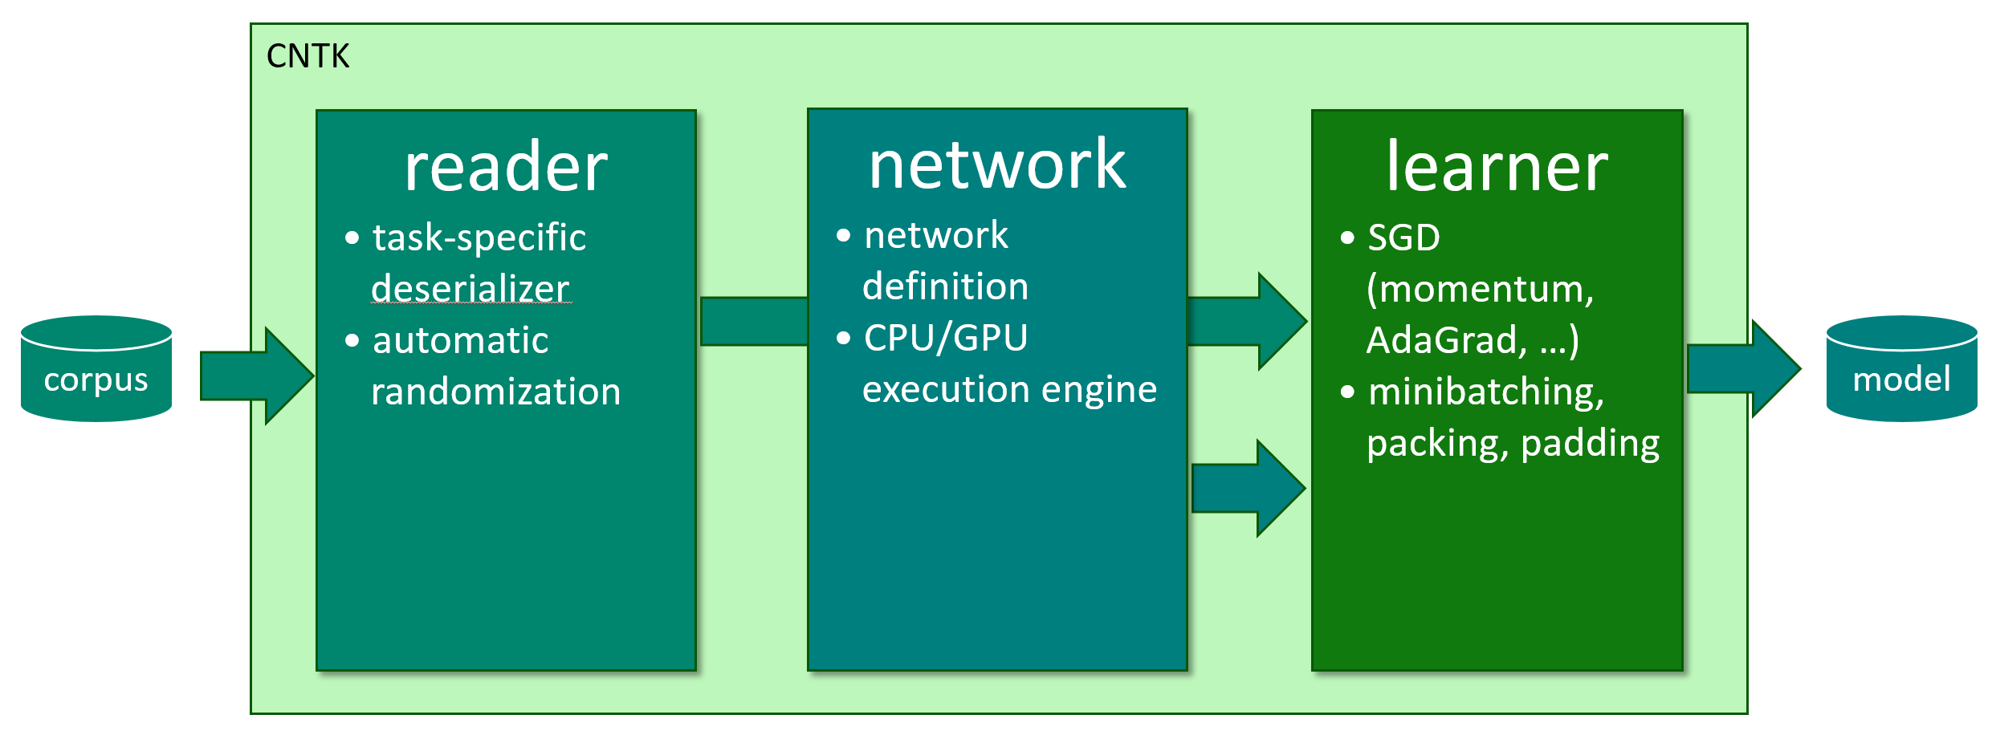
how to: top-level configuration
cntk configFile=yourConfig.cntk command="train:eval" root="exp-1"
# content of yourConfig.cntk:
train = [
action = "train"
deviceId = "auto"
modelPath = “$root$/models/model.dnn"
reader = [ … ]
BrainScriptNetworkBuilder = ( … )
SGD = [ … ]
]
eval = [ … ]
Notes:
note: emphasize $root$ to make it come out very clearly that variables inside can be overridden/tasks can be parameterized from the command-line

Slide 24
how to: reader
reader = [
readerType = "ImageReader"
file = "$ConfigDir$/train_map.txt"
randomize = “auto"
features = [ width=224; height=224; channels=3; cropRatio=0.875 ]
labels = [ labelDim=1000 ]
]
stock readers for images, speech (HTK), plain text, UCI
readers can be combined (e.g. image captioning)
custom format: implement IDeserializer
automatic on-the-fly randomization
randomizes data in chunks, then runs rolling window
no need to pre-randomize; important for large data sets
Notes:
(just explain: (1) deserialization incl. IDeserializer and (2) auto-randomization)

Slide 25
how to: network
network specification consists of:
inputs
the network function’s formula
including learnable parameters
(but no gradients, which are automatically determined by the system)
the output(s) and training/evaluation criteria
network descriptions are called “brain scripts”
custom network description language “BrainScript”
can soon be done using Python, C++, and C#/.Net

Slide 26
how to: network
ce
CrossEntropy
M = 40 ; N = 512 ; J = 9000 // feat/hid/out dim
x = Input(M) ; y = Input(J) // feat/labels
W1 = Parameter(N, M) ; b1 = Parameter(N)
W2 = Parameter(N, N) ; b2 = Parameter(N)
Wout = Parameter(J, N) ; bout = Parameter(J)
h1 = Sigmoid(W1 * x + b1)
h2 = Sigmoid(W2 * h1 + b2)
P = Softmax(Wout * h2 + bout)
ce = CrossEntropy(y, P)
P
Softmax
b_{out}
+
W_{out}
•
h₂
σ
b₂
+
W₂
•
h₁
σ
b₁
+
W₁
•
x
y

Slide 27
how to: network
ce
CrossEntropy
M = 40 ; N = 512 ; J = 9000 // feat/hid/out dim
x = Input(M) ; y = Input(J) // feat/labels
Layer (x, out, in, f) = [ // reusable block
W = Parameter(out, in) ; b = Parameter(out)
h = f(W * x + b)
].h
h1 = Sigmoid(W1 * x + b1)
h2 = Sigmoid(W2 * h1 + b2)
P = Softmax(Wout * h2 + bout)
ce = CrossEntropy(y, P)
P
Softmax
b_{out}
+
W_{out}
•
h₂
σ
b₂
+
W₂
•
h₁
σ
b₁
+
W₁
•
x
y

Slide 28
how to: network
ce
CrossEntropy
M = 40 ; N = 512 ; J = 9000 // feat/hid/out dim
x = Input(M) ; y = Input(J) // feat/labels
Layer (x, out, in, f) = [ // reusable block
W = Parameter(out, in) ; b = Parameter(out)
h = f(W * x + b)
].h
h1 = Layer(x, N, M, Sigmoid)
h2 = Layer(h1, N, N, Sigmoid)
P = Layer(h2, J, N, Softmax)
ce = CrossEntropy(y, P)
P
Softmax
b_{out}
+
W_{out}
•
h₂
σ
b₂
+
W₂
•
h₁
σ
b₁
+
W₁
•
x
y

Slide 29
how to: network
ce
CrossEntropy
M = 40 ; N = 512 ; J = 9000 // feat/hid/out dim
x = Input(M) ; y = Input(J) // feat/labels
Layer (x, out, in, f) = [ … ]
DNNStack (x, out, in, L) =
if L == 1 then Layer (x, out, in, Sigmoid)
else Layer (DNNStack (x, out, in, L-1),
out, out, Sigmoid)
h2 = Layer(h1, N, N, Sigmoid)
P = Layer(h2, J, N, Softmax)
ce = CrossEntropy(y, P)
P
Softmax
b_{out}
+
W_{out}
•
h₂
σ
b₂
+
W₂
•
h₁
σ
b₁
+
W₁
•
x
y
Notes:
functions can be recursive

Slide 30
how to: network
ce
CrossEntropy
M = 40 ; N = 512 ; J = 9000 ; L = 2
x = Input(M) ; y = Input(J) // feat/labels
Layer (x, out, in, f) = [ … ]
DNNStack (x, out, in, L) =
if L == 1 then Layer (x, out, in, Sigmoid)
else Layer (DNNStack (x, out, in, L-1),
out, out, Sigmoid)
hL = DNNStack(x, M, N, L) // parameterized
P = Layer(hL, J, N, Softmax)
ce = CrossEntropy(y, P)
P
Softmax
b_{out}
+
W_{out}
•
h₂
σ
b₂
+
W₂
•
h₁
σ
b₁
+
W₁
•
x
y
Notes:
allows to parameterize stack depth

Slide 31
how to: network
CNTK BrainScript:
straight-forward, easily understandable syntax
function definitions for reusable modules, e.g. layers
allows high-level composability
soon, BrainScripts can be written in Python, C++, and .Net
Notes:
note: this really just explained “programming”, but it’s important that it can be done

Slide 32
how to: “BrainScript??”
full name perfectly expresses our grand long-term ambition
two-letter acronym perfectly expresses today’s state of the degree that artificial neural networks actually implement brains
☺

Slide 33
how to: learner
SGD = [
maxEpochs = 50
minibatchSize = $mbSizes$
learningRatesPerSample = 0.007*2:0.0035
momentumAsTimeConstant = 1100
AutoAdjust = [ … ]
ParallelTrain = [ … ]
]
various model-update types like momentum, RmsProp, AdaGrad, …
learning rate and momentum can be specified in MB-size agnostic way
auto-adjustment of learning rate (e.g. “newbob”) and minibatch size
multi-GPU/multi-server
Notes:
standard features, plus (1) auto-tuning and (2) scale-out

Slide 34
how: typical workflow
configure reader, network, learner
train
CNTK configFile=myTask.cntk command=train

Slide 35
how: typical workflow
configure reader, network, learner
train & evaluate:
CNTK configFile=myTask.cntk command=train:eval

Slide 36
how: typical workflow
configure reader, network, learner
train & evaluate:
mpiexec --np 16 --hosts server1,server2,server3,server4 \ CNTK configFile=myTask.cntk command=train:eval parallelTrain=true deviceId=auto
Notes:
very simple to parallelize

Slide 37
how: typical workflow
configure reader, network, learner
train & evaluate:
mpiexec --np 16 --hosts server1,server2,server3,server4 \ CNTK configFile=myTask.cntk command=train:eval parallelTrain=true
modify models, e.g. for layer-building discriminative pre-training:
CNTK configFile=myTask.cntk command=train:editAddLayer:continueTrain
apply model file-to-file:
CNTK configFile=myTask.cntk command=write
use model from code: EvalDll.dll/.so (C++) or EvalWrapper.dll (.Net)

Slide 38
I. what II. how to III. deep dive IV. examples

Slide 39
deep dive
base features:
SGD with momentum, AdaGrad, Nesterov, etc.
computation network with automatic gradient
higher-level features:
auto-tuning of learning rate and minibatch size
memory sharing
implicit handling of time
minibatching of variable-length sequences
data-parallel training
you can do all this with other toolkits, but must write it yourself

Slide 40
deep dive
base features:
SGD with momentum, AdaGrad, Nesterov, etc.
computation network with automatic gradient
higher-level features:
auto-tuning of learning rate and minibatch size
memory sharing
implicit handling of time
minibatching of variable-length sequences
data-parallel training
you can do all this with other toolkits, but must write it yourself

Slide 41
deep dive: handling of time
extend our example to an RNN
h₁(t) = σ(W₁ x(t) + H₁ h₁(t-1) + b₁) h1 = Sigmoid(W1 * x + H1 * PastValue(h1) + b1)
h₂(t) = σ(W₂ h₁(t) + H₂ h₂(t-1) + b₂) h2 = Sigmoid(W2 * h1 + H2 * PastValue(h2) + b2)
P(t) = softmax(W_{out} h₂(t) + b_{out}) P = Softmax(Wout * h2 + bout)
ce(t) = L^{T}(t) log P(t) ce = CrossEntropy(L, P)
Σ_{corpus}ce(t) = max
→ no explicit notion of time

Slide 42
deep dive: handling of time
extend our example to an RNN
h₁(t) = σ(W₁ x(t) + H₁ h₁(t-1) + b₁) h1 = Sigmoid(W1 * x + H1 * PastValue(h1) + b1)
h₂(t) = σ(W₂ h₁(t) + H₂ h₂(t-1) + b₂) h2 = Sigmoid(W2 * h1 + H2 * PastValue(h2) + b2)
P(t) = softmax(W_{out} h₂(t) + b_{out}) P = Softmax(Wout * h2 + bout)
ce(t) = L^{T}(t) log P(t) ce = CrossEntropy(L, P)
Σ_{corpus}ce(t) = max
→ no explicit notion of time
Notes:
add notion of time

Slide 43
deep dive: handling of time
extend our example to an RNN
h₁(t) = σ(W₁ x(t) + H₁ h₁(t-1) + b₁) h1 = Sigmoid(W1 * x + H1 * PastValue(h1) + b1)
h₂(t) = σ(W₂ h₁(t) + H₂ h₂(t-1) + b₂) h2 = Sigmoid(W2 * h1 + H2 * PastValue(h2) + b2)
P(t) = softmax(W_{out} h₂(t) + b_{out}) P = Softmax(Wout * h2 + bout)
ce(t) = L^{T}(t) log P(t) ce = CrossEntropy(L, P)
Σ_{corpus}ce(t) = max
→ no explicit notion of time
Notes:
add recurrent connection

Slide 44
deep dive: handling of time
extend our example to an RNN
h₁(t) = σ(W₁ x(t) + H₁ h₁(t-1) + b₁) h1 = Sigmoid(W1 * x + H1 * PastValue(h1) + b1)
h₂(t) = σ(W₂ h₁(t) + H₂ h₂(t-1) + b₂) h2 = Sigmoid(W2 * h1 + H2 * PastValue(h2) + b2)
P(t) = softmax(W_{out} h₂(t) + b_{out}) P = Softmax(Wout * h2 + bout)
ce(t) = L^{T}(t) log P(t) ce = CrossEntropy(L, P)
Σ_{corpus}ce(t) = max
→ no explicit notion of time
Notes:
note: PastValue is a special operation, but not a keyword. E.g. PastValue (PastValue (x)) is possible.

Slide 45
deep dive: handling of time
h1 = Sigmoid(W1 * x + H1 * PastValue(h1) + b1)
h2 = Sigmoid(W2 * h1 + H2 * PastValue(h2) + b2)
P = Softmax(Wout * h2 + bout)
ce = CrossEntropy(L, P)

Slide 46
deep dive: handling of time
h1 = Sigmoid(W1 * x + H1 * PastValue(h1) + b1)
h2 = Sigmoid(W2 * h1 + H2 * PastValue(h2) + b2)
P = Softmax(Wout * h2 + bout)
ce = CrossEntropy(L, P)
ce
CrossEntropy
P
Softmax
b_{out}
+
W_{out}
•
h₂
σ
b₂
+
W₂
•
h₁
σ
b₁
+
W₁
•
x
y
Notes:
“met me make some space”

Slide 47
deep dive: handling of time
p d
ep di
ce
CrossEntropy
h1 = Sigmoid(W1 * x + H1 * PastValue(h1) + b1)
h2 = Sigmoid(W2 * h1 + H2 * PastValue(h2) + b2)
P = Softmax(Wout * h2 + bout)
ce = CrossEntropy(L, P)
P
Softmax
b_{out}
+
W_{out}
•
h₂
σ
b₂
+
W₂
•
h₁
σ
b₁
+
W₁
•
x
y

Slide 48
deep dive: handling of time
p d
ep di
ce
CrossEntropy
h1 = Sigmoid(W1 * x + H1 * PastValue(h1) + b1)
h2 = Sigmoid(W2 * h1 + H2 * PastValue(h2) + b2)
P = Softmax(Wout * h2 + bout)
ce = CrossEntropy(L, P)
CNTK automatically unrolls cycles
cycles are detected with Tarjan’s algorithm
loops become part of deferred computation
only nodes in cycles are unrolled
efficient and composable
cf. TensorFlow, where recurrence must be manually unrolled in imperative code: [https://www.tensorflow.org/versions/r0.8/tutorials/recurrent/index.html]
lstm = rnn_cell.BasicLSTMCell(lstm_size)
state = tf.zeros([batch_size, lstm.state_size])
for current_batch_of_words in words_in_dataset:
output, state = lstm(current_batch_of_words, state)
P
Softmax
b_{out}
+
W_{out}
•
h₂
σ
z⁻¹
+
•
b₂
+
H₂
W₂
•
h₁
σ
z⁻¹
+
•
b₁
+
H₁
W₁
•
x
y

Slide 49
deep dive: variable-length sequences
minibatches containing sequences of different lengths are automatically packed and padded
CNTK handles the special cases:
PastValue operation correctly resets state and gradient at sequence boundaries
non-recurrent operations just pretend there is no padding (“garbage-in/garbage-out”)
sequence reductions
time steps computed in parallel
sequence 1
sequence 2
sequence 3
padding
parallel sequences
sequence 4
sequence 7
sequence 5
sequence 6

Slide 50
deep dive: variable-length sequences
minibatches containing sequences of different lengths are automatically packed and padded
CNTK handles the special cases:
PastValue operation correctly resets state and gradient at sequence boundaries
non-recurrent operations just pretend there is no padding (“garbage-in/garbage-out”)
sequence reductions
time steps computed in parallel
sequence 1
sequence 2
sequence 3
padding
parallel sequences
sequence 4
sequence 7
sequence 5
sequence 6

Slide 51
deep dive: variable-length sequences
minibatches containing sequences of different lengths are automatically packed and padded
CNTK handles the special cases:
PastValue operation correctly resets state and gradient at sequence boundaries
non-recurrent operations just pretend there is no padding (“garbage-in/garbage-out”)
sequence reductions
time steps computed in parallel
sequence 1
sequence 2
sequence 3
padding
parallel sequences
sequence 4
sequence 7
sequence 5
sequence 6

Slide 52
deep dive: variable-length sequences
minibatches containing sequences of different lengths are automatically packed and padded
CNTK handles the special cases:
PastValue operation correctly resets state and gradient at sequence boundaries
non-recurrent operations just pretend there is no padding (“garbage-in/garbage-out”)
sequence reductions
time steps computed in parallel
sequence 1
sequence 2
sequence 3
padding
parallel sequences
sequence 4
sequence 7
sequence 5
sequence 6

Slide 53
deep dive: variable-length sequences
minibatches containing sequences of different lengths are automatically packed and padded
CNTK handles the special cases:
PastValue operation correctly resets state and gradient at sequence boundaries
non-recurrent operations just pretend there is no padding (“garbage-in/garbage-out”)
sequence reductions
time steps computed in parallel
sequence 1
sequence 2
sequence 3
padding
parallel sequences
sequence 4
sequence 7
sequence 5
sequence 6

Slide 54
deep dive: variable-length sequences
minibatches containing sequences of different lengths are automatically packed and padded
CNTK handles the special cases:
PastValue operation correctly resets state and gradient at sequence boundaries
non-recurrent operations just pretend there is no padding (“garbage-in/garbage-out”)
sequence reductions
time steps computed in parallel
sequence 1
sequence 2
sequence 3
padding
parallel sequences
sequence 4
sequence 7
sequence 5
sequence 6

Slide 55
deep dive: variable-length sequences
minibatches containing sequences of different lengths are automatically packed and padded
CNTK handles the special cases:
PastValue operation correctly resets state and gradient at sequence boundaries
non-recurrent operations just pretend there is no padding (“garbage-in/garbage-out”)
sequence reductions
time steps computed in parallel
sequence 1
sequence 2
sequence 3
padding
parallel sequences
sequence 4
sequence 7
sequence 5
sequence 6

Slide 56
deep dive: variable-length sequences
minibatches containing sequences of different lengths are automatically packed and padded
CNTK handles the special cases:
PastValue operation correctly resets state and gradient at sequence boundaries
non-recurrent operations just pretend there is no padding (“garbage-in/garbage-out”)
sequence reductions
time steps computed in parallel
sequence 1
sequence 2
sequence 3
padding
parallel sequences
sequence 4
sequence 7
sequence 5
sequence 6

Slide 57
deep dive: variable-length sequences
minibatches containing sequences of different lengths are automatically packed and padded
CNTK handles the special cases:
PastValue operation correctly resets state and gradient at sequence boundaries
non-recurrent operations just pretend there is no padding (“garbage-in/garbage-out”)
sequence reductions
time steps computed in parallel
sequence 1
sequence 2
sequence 3
padding
parallel sequences
sequence 4
sequence 7
sequence 5
sequence 6

Slide 58
deep dive: variable-length sequences
minibatches containing sequences of different lengths are automatically packed and padded
speed-up is automatic:
time steps computed in parallel
sequence 1
sequence 2
sequence 3
padding
parallel sequences
sequence 4
sequence 7
sequence 5
sequence 6

Slide 59
recap
users never explicitly see time axes
CNTK infers loops from PastValue (and FutureValue) operations
graph looks like signal processing
CNTK automatically batches, packs, and pads sequences into minibatches
and computes the right thing
Look, Ma, no bucketing!

Slide 60
deep dive: data-parallel training
data-parallelism: distribute each minibatch over workers, then aggregate
challenge: communication cost
optimal iff compute and communication time per minibatch is equal (assuming overlapped processing)
example: DNN, MB size 1024, 160M model parameters
compute per MB: 1/7 second
communication per MB: 1/9 second (640M over 6 GB/s)
can’t even parallelize to 2 GPUs: communication cost already dominates!
approach:
communicate less → 1-bit SGD
communicate less often → automatic MB sizing; Block Momentum
Notes:
computation and communication of same order of magnitude in this example;
(If not doing overlapped processing, then) example can at most speed-up by factor of ~2 if communication cost is half the total time, and not parallelized
(and if doing, then it cannot be parallelized at all, basically)

Slide 61
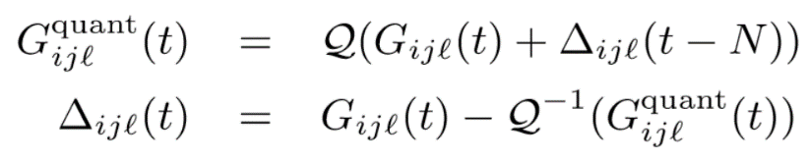
deep dive: 1-bit SGD
quantize gradients to but 1 bit per value with error feedback
carries over quantization error to next minibatch
1-Bit Stochastic Gradient Descent and its Application to Data-Parallel Distributed Training of Speech DNNs, InterSpeech 2014, F. Seide, H. Fu, J. Droppo, G. Li, D. Yu

Slide 62
deep dive: automatic minibatch scaling
goal: communicate less often
every now and then try to grow MB size on small subset
important: keep contribution per sample and momentum effect constant
hence define learning rate and momentum in a MB-size agnostic fashion
quickly scales up to MB sizes of 3k; runs at up to 100k samples

Slide 63
deep dive: Block Momentum
very recent, very effective parallelization method
goal: avoid to communicate after every minibatch
run a block of many minibatches without synchronization
then exchange and update with “block gradient”
problem: taking such a large step causes divergence
approach:
only add 1/K-th of the block gradient (K=#workers)
and carry over the missing (1-1/K) to the next block update (error residual like 1-bit SGD)
same as the common momentum formula
K. Chen, Q. Huo: “Scalable training of deep learning machines by incremental block training with intra-block parallel optimization and blockwise model-update filtering,” ICASSP 2016

Slide 64
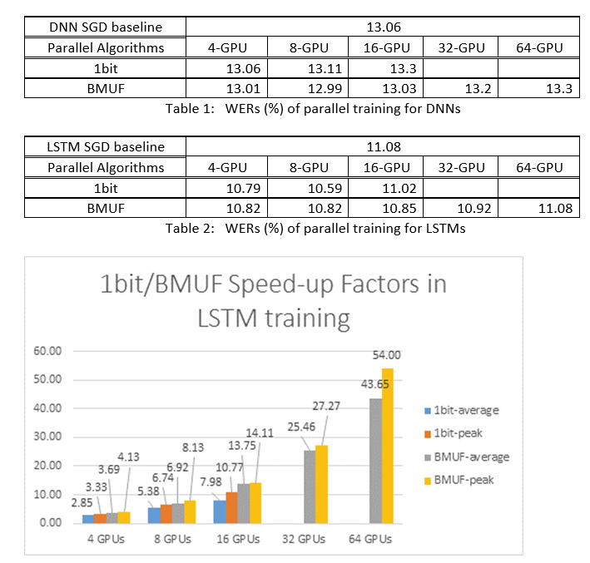
deep dive: data-parallel training
[Yongqiang Wang, internal communication]

Slide 65
recap
CNTK can parallelize training across multiple GPUs and multiple servers
extremely easy to use: mpiexec + parallelTrain option
enables to handle production workloads
two methods based on error-feedback: 1-bit, Block Momentum

Slide 66
I. what II. how III. deep dive IV. examples

Slide 67
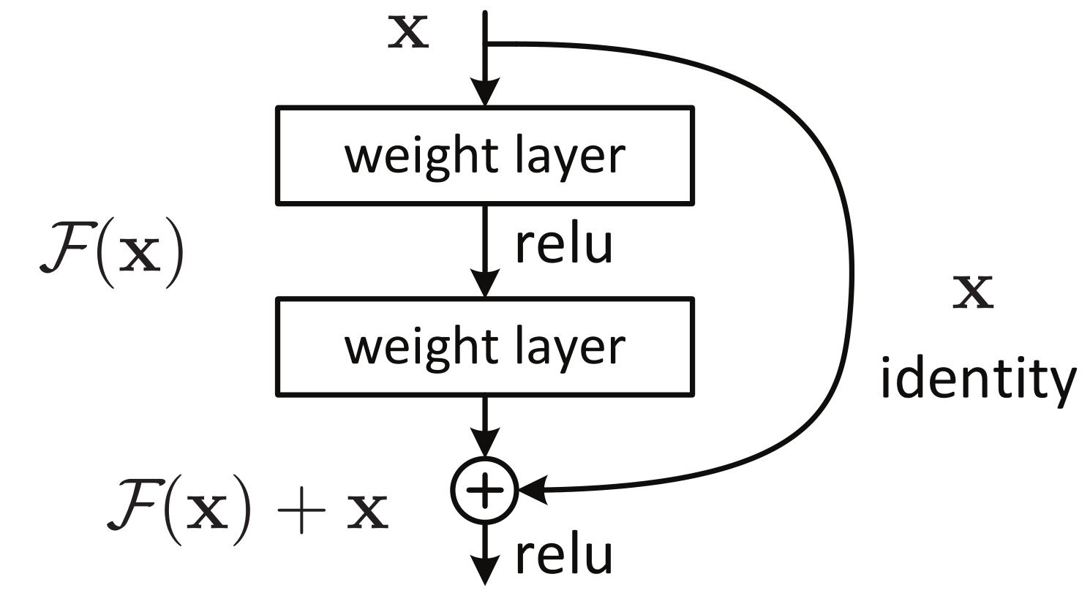
examples: image ResNet
reformulate the layers as learning residual functions with reference to the layer inputs
residual networks are easier to optimize → allows for “Ultra-Deep” networks: 152 layers!
won 1-st places in all 5 entries of ILSVRC 2015
K. He: “Deep Residual Learning for Image Recognition,” ICCV 2015

Slide 68
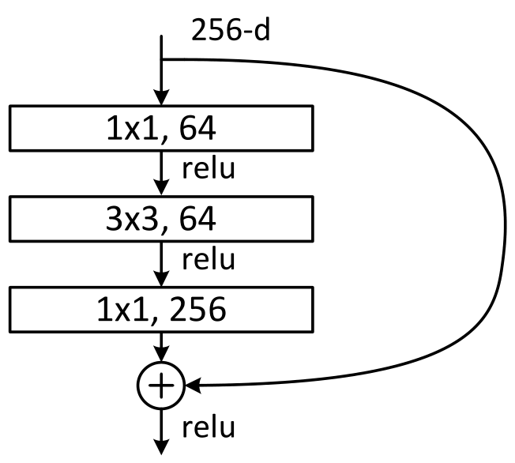
examples: image (ResNet)
ResNetLayer (inp, inMap, convMap, outMap, convWCount) =
[
c1 = RectifiedLinear (ConvBNLayer (inp, convMap, inMap, 1, 1, 1, 1))
c2 = RectifiedLinear (ConvBNLayer (c1, convMap, convWCount, 3, 3, 1, 1))
y = RectifiedLinear (ConvBNLayer (c2, outMap, convMap, 1, 1, 1, 1)
+ inp)
].y

Slide 69
examples: image (ResNet)
ResNetLayer (inp, inMap, convMap, outMap, convWCount) =
[
c1 = RectifiedLinear (ConvBNLayer (inp, convMap, inMap, 1, 1, 1, 1))
c2 = RectifiedLinear (ConvBNLayer (c1, convMap, convWCount, 3, 3, 1, 1))
y = RectifiedLinear (ConvBNLayer (c2, outMap, convMap, 1, 1, 1, 1)
+ inp)
].y
ConvBNLayer (inp, outMap, inMap, kW, kH, hStride, vStride) =
[
W = Parameter (outMap, inMap, init=“Gaussian”, initValueScale=wScale)
c = Convolution (W, inp, kW, kH, outMap, hStride, vStride, zeroPadding=true, imageLayout="cudnn")
y = BNLayer (c, outMap)
].y
BNLayer (inp, mapCount) =
[
b = Parameter (mapCount, 1, init=“fixedValue”, value=bValue)
sc = Parameter (mapCount, 1, init=“fixedValue”, value=scValue)
m = Parameter (mapCount, 1, init=“fixedValue”, value=0, learningRateMultiplier=0)
isd = Parameter (mapCount, 1, init=“fixedValue”, value=0, learningRateMultiplier=0)
y = BatchNormalization (inp, sc, b, m, isd, spatial=true, normalizationTimeConstant=bnTimeConst, imageLayout="cudnn")
].y

Slide 70
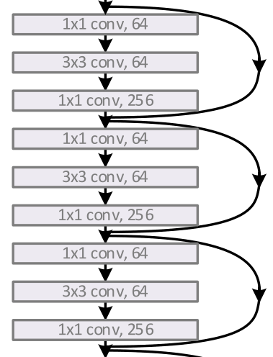
examples: image (ResNet)
# 152-layer residual with bottleneck
ResNetLayers (N, in, inMap, convMap, outMap, convWCount, projStride, stride1x1, stride3x3) =
if N == 1
then
ResNetLayerInc (in, inMap, inMap, outMap, convWCount, projStride, stride1x1, stride3x3)
else
ResNetLayer (ResNetLayers (N-1, in, inMap, convMap, outMap, convWCount, projStride, stride1x1, stride3x3),
outMap, convMap, outMap, convWCount)
Notes:
same recursive definition as explained earlier, very handy for these deep networks

Slide 71
examples: image (ResNet)
# 152-layer residual with bottleneck
ResNetLayers (N, in, inMap, convMap, outMap, convWCount, projStride, stride1x1, stride3x3) =
if N == 1
then
ResNetLayerInc (in, inMap, inMap, outMap, convWCount, projStride, stride1x1, stride3x3)
else
ResNetLayer (ResNetLayers (N-1, in, inMap, convMap, outMap, convWCount, projStride, stride1x1, stride3x3),
outMap, convMap, outMap, convWCount)
features = ImageInput (imageW, imageH, imageC, imageLayout="cudnn", tag="feature")
labels = Input (labelDim, tag="label")
conv1 = ConvBNReLULayer (features, cMap1, 147, 7, 7, 2, 2)
pool1 = MaxPooling (conv1, pool1W, pool1H, pool1hs, pool1vs, imageLayout="cudnn")
rn1 = ResNetLayers ( 3, pool1, cMap1, cMap1, cMap3, 576, 1, 1, 1)
rn2 = ResNetLayers ( 8, rn1, cMap3, cMap2, cMap4, 1152, 2, 1, 2)
rn3 = ResNetLayers (36, rn2, cMap4, cMap3, cMap5, 2304, 2, 1, 2)
rn4 = ResNetLayers ( 3, rn3, cMap5, cMap4, cMap6, 4608, 2, 1, 2)
pool2 = AveragePooling (rn4, pool2W, pool2H, pool2hs, pool2vs, imageLayout="cudnn")
ol = LinearLayer (pool2)
ce = CrossEntropyWithSoftmax (labels, ol, tag="criterion")
Notes:
with those few reusable blocks, main network can be described in 11 lines

Slide 72
recap
convolution, pooling, batch normalization are standard operations
152 layer non-standard model described concisely

Slide 73
examples: sequence-to-sequence
sequence-to-sequence model with attention (and beam search)
applied to letter-to-sound conversion (how to pronounce a word)
encoder LSTM-RNN encodes input word, letter by letter, into a hidden sequence
decoder LSTM-RNN generates phoneme sequence from encoder sequence
attention: learns weight over input letters for output phoneme → weighted average
use beam search to find globally optimum pronunciation
input and label have different time axes
beam decoder can be written as a BrainScript as well using tensors and matrix products, no custom C++ code needed
CNTK gets WERs very close (23.9%) to world record (23.6%)
Bahdanau et al.: “Neural machine translation by joinylu learning to align and translate,” ICLR 2015

Slide 74
examples: sequence-to-sequence
# inputs
inputAxis = DynamicAxis()
input = Input (inputVocabDim, dynamicAxis=inputAxis, tag='feature')
labels = Input (labelVocabDim, tag='label')
# encoder and attention window
encoder = RecurrentLSTMStack (encoderDims, input)
attentionWindow = PastValueWindow (attentionSpan, encoder[Length (encoderDims)-1].h)
AttentionHook (input, prevState) =
[
u = v * Tanh (Wenc * attentionWindow + Wdec * prevState.h)
attentionWeights = Softmax (u, axis=2)
weightedAttentionWindow = attentionWindow .* attentionWeights
weightedAttentionAverage = ReduceSum (weightedAttentionWindow, axis=2)
].weightedAttentionAverage
# decoder and output
decoder = RecurrentLSTMStack (decoderDims, labels, augmentInputHook=AttentionHook)
z = Wout * S(decoderOutput) + Bout // top-level input to Softmax
ce = CrossEntropyWithSoftmax (labels, z)

Slide 75
examples: sequence-to-sequence
# LSTM layer(s)
RecurrentLSTMStack (layerDims, input, augmentInputHook=NoAuxInputHook) =
[
layers[i:0..Length (layerDims)-1] =
RecurrentLSTM (layerDims[i], if i == 0 then input else layers[i-1].h,
augmentInputHook=if i == 0 then ^.augmentInputHook else NoAuxInputHook)
].layers
RecurrentLSTM (outputDim, x, augmentInputHook=NoAuxInputHook) =
[
prevState = [ h = PastValue (lstmState.h); c = PastValue (lstmState.c) ]
auxInput = augmentInputHook(x, prevState) # for attention model
lstmState = LSTM (outputDim, x, aux=auxInput, prevState)
].lstmState // that's the value we return

Slide 76
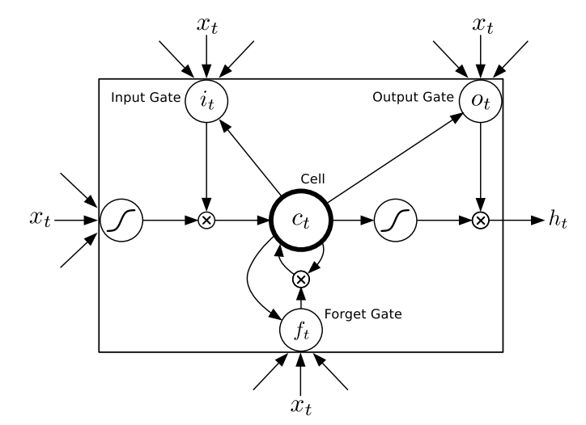
examples: sequence-to-sequence
x_{t}, a_{t}, h_{t-1}
x_{t}, a_{t}, h_{t-1}
# LSTM as a BrainScript
LSTM (outputDim, x, aux=None, prevState) =
[
ph = prevState.h; pc = prevState.c // delayed values, shown as z⁻¹ →
B() = BiasParam (outputDim)
W() = WeightParam (outputDim, inputDim) // input-to-hidden
A() = WeightParam (outputDim, auxDim) // aux input-to-hidden
H() = WeightParam (outputDim, outputDim) // hidden-to-hidden
C() = DiagWeightParam (outputDim) // cell-to-hiddden (note: applied elementwise)
pin() = if IsNone (aux)
then B() + W() * x // non-recurrent portions if no aux input
else B() + W() * x + A() * aux // and with aux input
it = Sigmoid (pin() + H() * ph + C() .* pc) // input gate(t)
ft = Sigmoid (pin() + H() * ph + C() .* pc) // forget-me-not gate(t)
ot = Sigmoid (pin() + H() * ph + C() .* c) // output gate(t)
bit = it .* Tanh (pin() + H() * ph) // input gate applied to tanh of input network
bft = ft .* pc // forget-me-not gate applied to cell(t-1)
c = bft + bit // c(t) is sum of both
h = ot .* Tanh (c) // output gate applied to tanh(cell(t))
]
x_{t}, a_{t}, h_{t-1}
z⁻¹
z⁻¹
z⁻¹
x_{t}, a_{t}, h_{t-1}
Notes:
completely specified in BrainScript; easy to e.g. change to a GRU

Slide 77
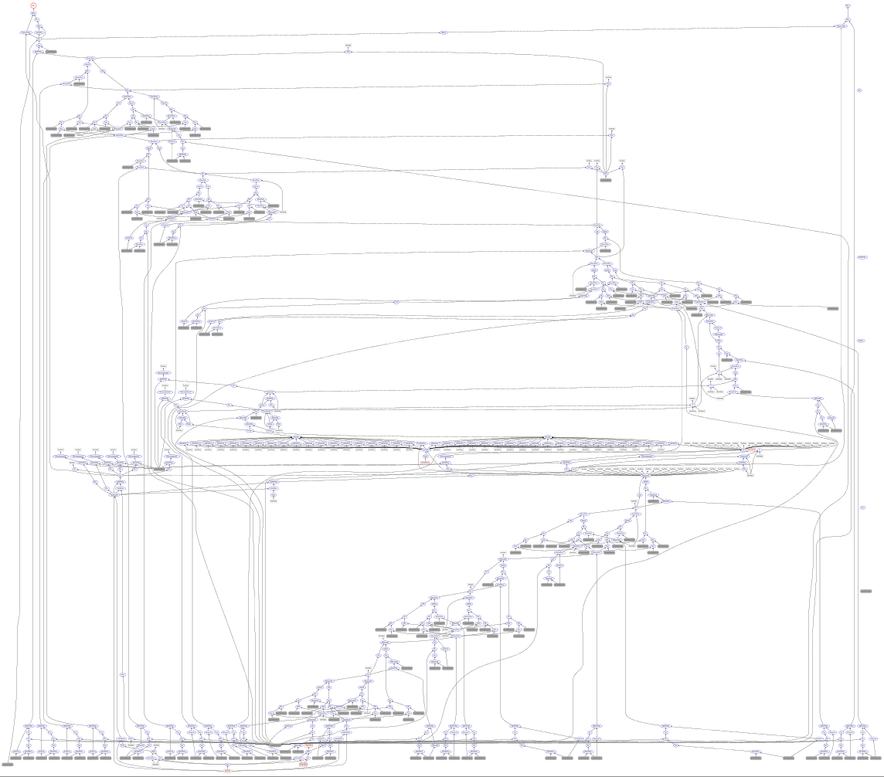
Notes:
600 nodes, yet only few pages of very clear code

Slide 78
I. what II. how to III. deep dive IV. examples

Slide 79
on our roadmap
CNTK as a library
Python/C++/.Net
code reuse for data reading
network building in familiar language
finer control of SGD; non-standard loops e.g. RL
expressiveness: nested loops, more sparse support
large models: model parallelism, memory swapping, 16-bit floats
Azure: power GPUs becoming available soon

Slide 80
conclusion
CNTK is Microsoft’s open-source, cross-platform toolkit for learning and evaluating deep neural networks.
Linux, Windows, docker, .Net
CNTK expresses (nearly) arbitrary neural networks by composing simple building blocks into complex computational networks, supporting relevant network types and applications.
automatic differentiation, deferred computation, optimized execution and memory use
powerful description language, composability
implicit time; efficient static and recurrent NN training through batching
data parallelization, GPUs & servers: 1-bit SGD, Block Momentum
feed-forward DNN, RNN, LSTM, convolution, DSSM; speech, vision, text
CNTK is production-ready: State-of-the-art accuracy, efficient, and scales to multi-GPU/multi-server.

Slide 81
additional resources
CNTK:
https://github.com/Microsoft/CNTK
contains all the source code and many example setups
MIT license
you may understand better how CNTK works by reading the source code
new features are added constantly
contact:
CNTK team: ask a question on CNTK GitHub (Issues)!
mailto:fseide@microsoft.com

Slide 82
END

